Slide 1
UNIT - 2
Spreadsheet functions to organize data Part-2

Slide 2
Formula Auditing
Auditing Tools are used while working with formulae.
It will help us to track which cells are involved in the given formula using Formula Tab.
With the help of the show formula option, we can check all the formulae used in the given worksheet.
Other options are Trace Precedents, Trace Dependents.

Slide 3
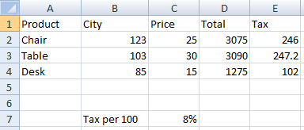

Slide 4
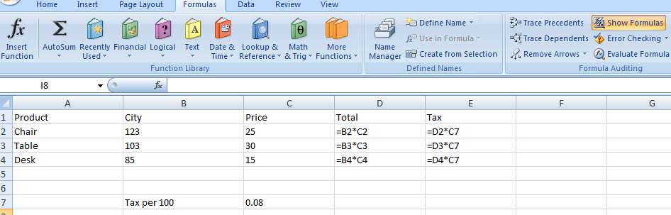
Use of Show Formulas
It will show all the formulas used

Slide 5
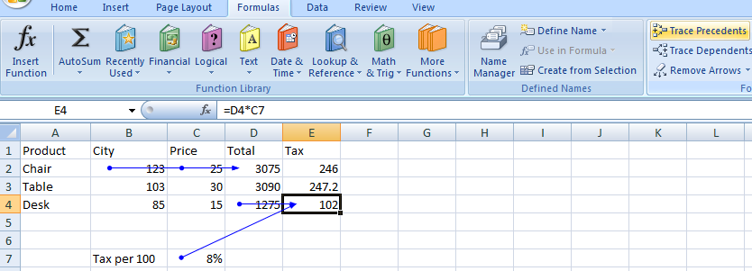
Use of Trace Precedents
It is used to show which cells are involved in the given formula with the help of arrows.

Slide 6
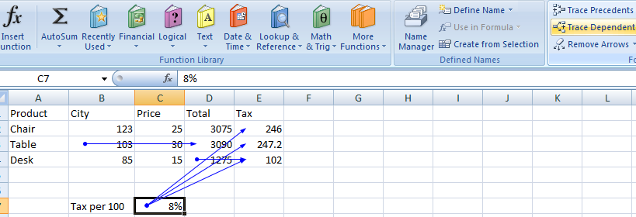
Use of Trace Dependents

Slide 7
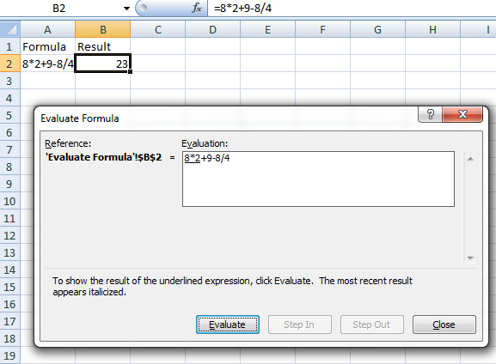
Evaluate Formula

Slide 8
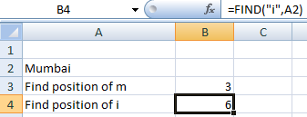
Remaining Text Functions
Find function is used to find the position of any character in the given text

Slide 9
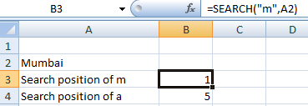
Search is also used to find the position of any character in the given text. The difference between search and find is that, Find is case sensitive but search is not case sensitive.

Slide 10
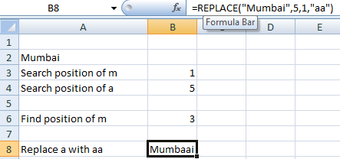
Replace function is used to replace a part of text with new text

Slide 11
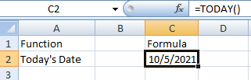
Remaining Date and Time Functions
Today() is used to find today’s date

Slide 12
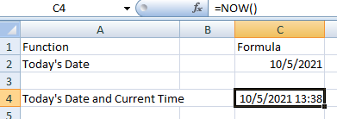
Now() is used to find current date and time

Slide 13
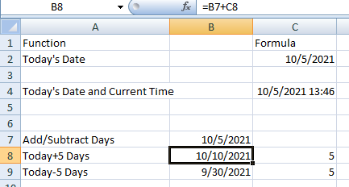
Adding some days to the current day

Slide 14
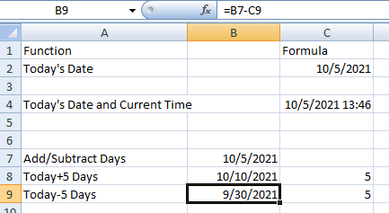
Subtracting some days from the current day

Slide 15
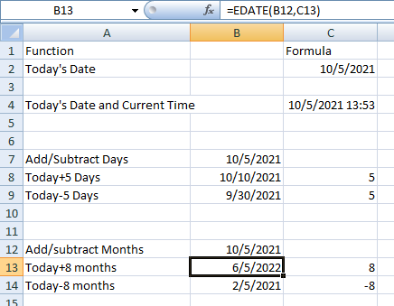
Edate function is used to add or subtract months in a date. Here it is used to add 8 months to the current date

Slide 16
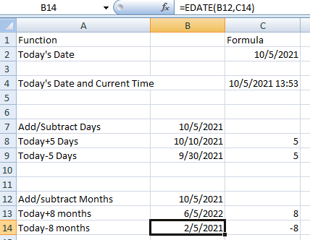
Here edate function is used to subtract 8 months from the current month

Slide 17
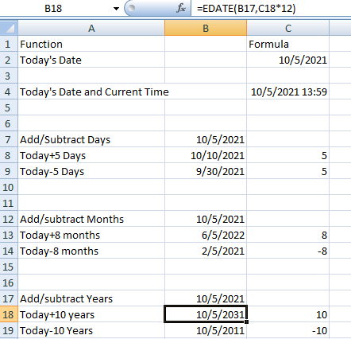
Adding 10 years to current date

Slide 18
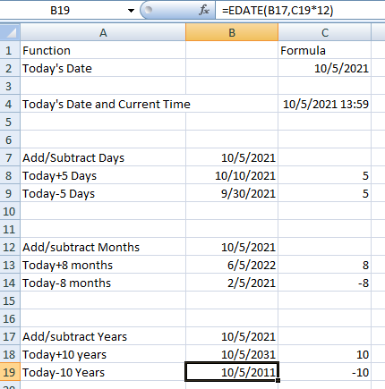
Subtracting 10 years from the current date

Slide 19
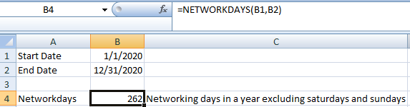
Networkdays() is used to find the net-working days in a year

Slide 20
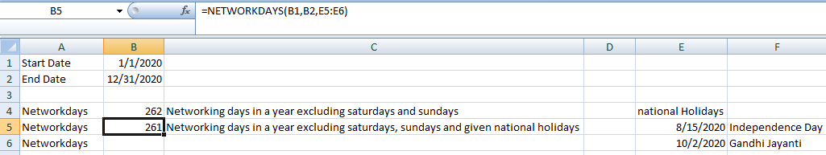
Networkdays() is also used to calculate net-working days in a year excluding saturdays, sundays and other national holidays

Slide 21
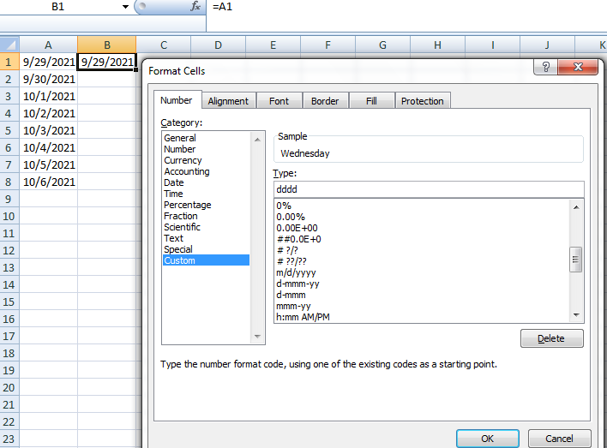
With the help of custom formatting, we can display date vs day

Slide 22
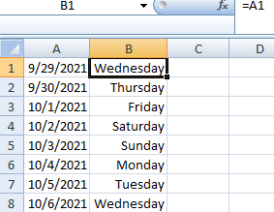

Slide 23
Name Range
Name Range is used to get the particular sheet among multiple sheets.
As if there are so many sheets, so remembering name of every sheet would be the difficult task.
With the help of this name range, we can reach that sheet from any other sheet.

Slide 24
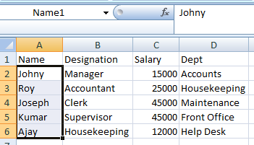
Creating a Name Range
For cell a2 : a6, name range has been given as Name1. From another sheet, using the cell name drop down this sheet can be found. It is used for navigating between the worksheets in the workbook

Slide 25
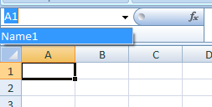

Slide 26
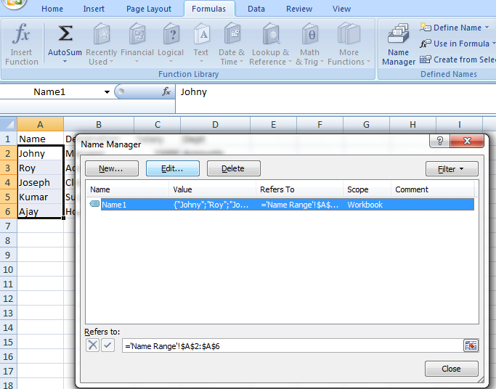
Renaming a Name Range
Go to the formula tab, Name Manager, Select the existing name, and then click on edit. Add a new name and then Ok

Slide 27
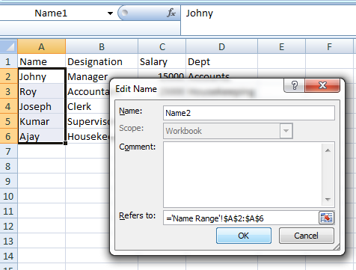

Slide 28
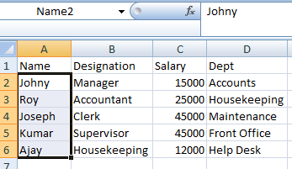

Slide 29
Similarly from this Name Manager, we can create a Name Range, Edit a Name Range and Delete a Name Range.
Name Range can also be given to more than one column.
For that, select all those columns, then formula tab, then create from selection and then choose what names you want to use.

Slide 30
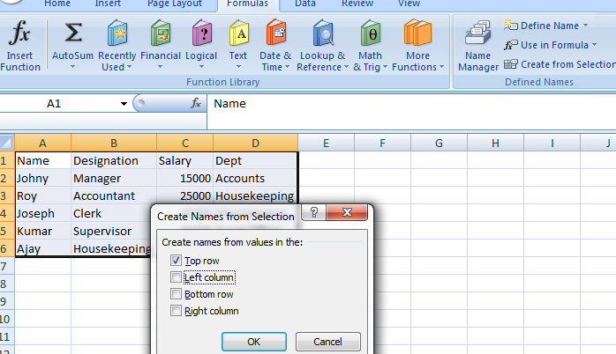

Slide 31
Count Functions
Count

